Slide 1
Capstone Project
Retail Sail Prediction
Team Members
Ankit Patel
Abhishek Singh
Shweta Shivhare
Shubham Chavhan
Sushmita Choudhary

Slide 2
CONTENTS
Introduction
Problem Statement
Data Summary
Methodology
Loading the data
Exploratory Data Analysis
Treating missing values and outliers
Feature engineering
Train test split
Data Modeling
Model interpretation
Train and test interpretation
Conclusion

Slide 3
INTRODUCTION
When Dirk Rossmann opened his first shop in 1972 in Hanover, Rossmann is the first German brand to introduce discount health and beauty retail concept to the nation. Within a decade, Rossmann had progressed rapidly and became the market leader in northern Germany with 100 stores.
Today, Rossmann operates over 4,200 stores in Germany, Poland, Hungary, Czech Republic, Albania and Kosovo with over 56,000 employees all over Europe.

Slide 4
PROBLEM STATEMENT
Rossmann operates over 3,000 drug stores in 7 European countries. Currently, Rossmann store managers are tasked with predicting their daily sales for up to six weeks in advance. Store sales are influenced by many factors, including promotions, competition, school and state holidays, seasonality, and locality. With thousands of individual managers predicting sales based on their unique circumstances, the accuracy of results can be quite varied.
We have provided with historical sales data for 1,115 Rossmann stores. The task is to forecast the "Sales" column for the test set. Note that some stores in the dataset were temporarily closed for refurbishment.

Slide 5
Data Summary
The datasets have the data of over three years - 2013, 2014 and 2015. We have given 2 dataset and below are few important features:
Customer : - The Number of customers on a given day in a store.
State Holiday :- Indicates a state holiday.
Store Type : - Differentiate between 4 different store models.
Assortment : - Describes an assortment level i.e a : basic, b : extra and c : extended.
Competition Distance : - Distance in meters to the nearest competition store.

Slide 6
Data Summary (Contd.)
CompetitionOpenSince[Year/Month] : - Gives the approximate year and month of the time the nearest competitor is opened.
Promo : - Indicates whether a store is running a promo on that day.
Promo2 : - Indicates whether a store is continuing promotion.
Promo2Since[Year/Week] : - Gives the approximate year and calendar week of the time when the store started participating in Promo2.
PromoInterval : - Describes an interval or name of months when the store runs Promo2.

Slide 7
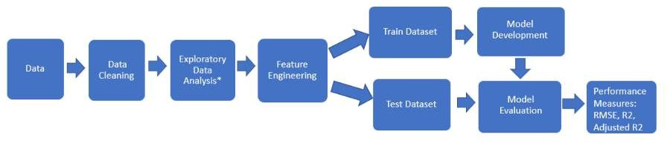
METHODOLOGY

Slide 8
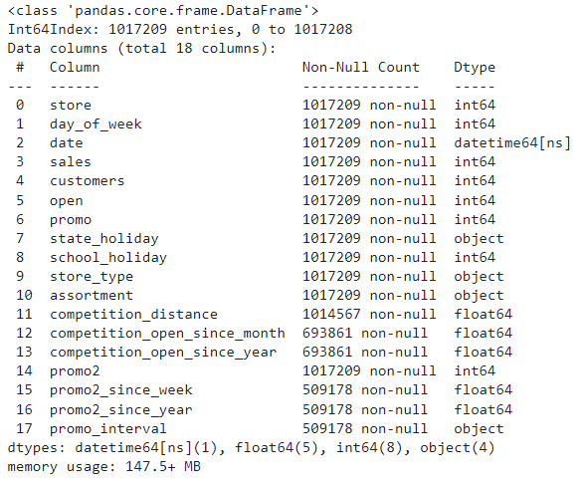

LOADING THE DATA AND DATA CLEANING
After loading the data, we can observe that the data frame contains
1017209 rows with 18 variables. And we are trying to have an insight on missing values

Slide 9
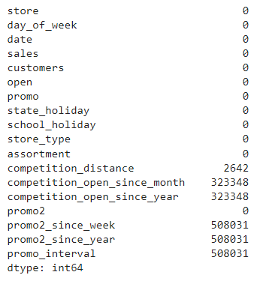
SPREAD OF MISSING VALUES

Slide 10
Hypothesis Mind Map
To better understand the relationship between the target variable (sales) and the features, I'll create some hypothesis based on the business problem to guide the feature engineering and then the exploratory data analysis.
In the EDA section, I'll validate these hypothesis and it'll let me have a good notion about the relation between the features and the target and it will help me to choose more accurately what feature to use when modeling.
This, the following hypothesis final list is created.
Stores with a larger assortment should sell more.
Stores with closer competitors should sell less.
Stores with longer competitors should sell more
Stores with active promotions for longer should sell more.
Stores with more promotion days should sell more.
Stores with more consecutive promotions should sell more.
Stores open during the Christmas holiday should sell more.
Stores should be selling more over the years.
Stores should sell more in the second half of the year.
Stores should sell more after the 10th of each month.
Stores should sell less on weekends.
Stores should sell less during school holidays.

Slide 11
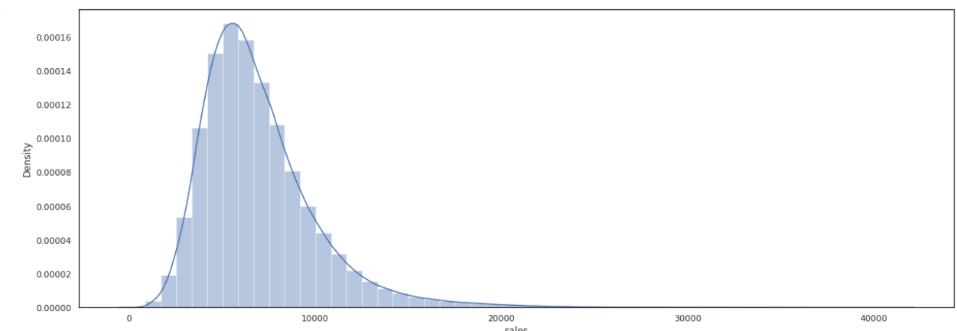
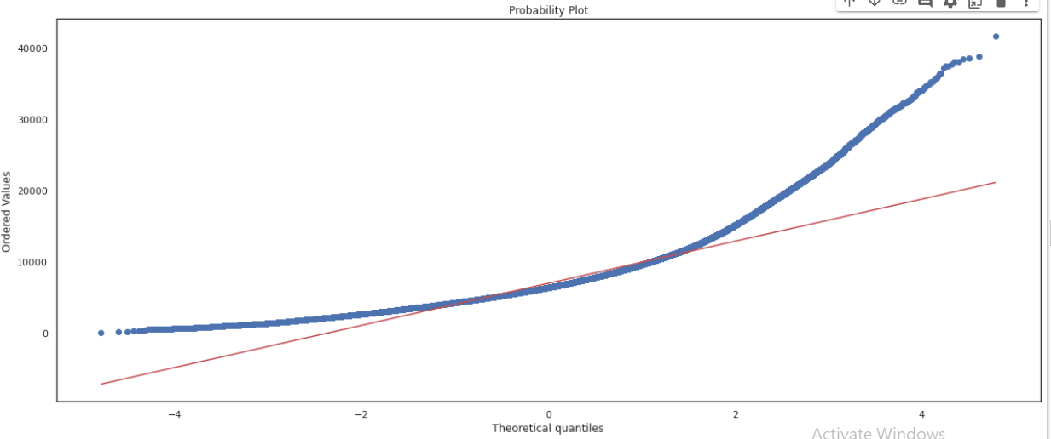
Exploratory Data Analysis ( EDA)
Some ML algorithms needs the data to be normal. Let's check if the sales distribution is normal. First, let's look at a q-q plot and then at a Shapiro-Wilk test for normality.
As show in the right plot , sales distribution don't seem to be normal.

Slide 12
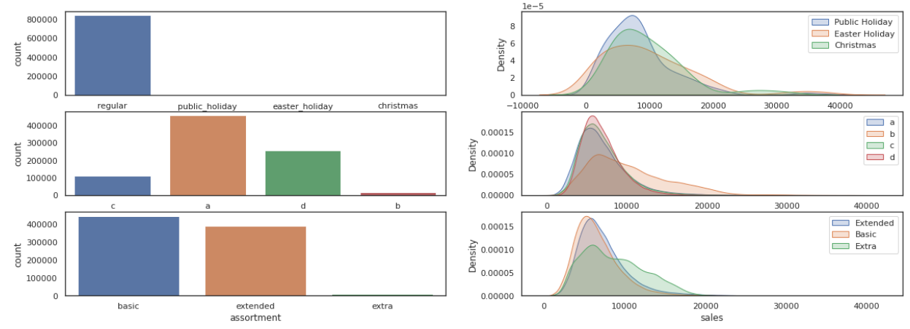
EDA(Contd.)
Conclusions:
There's a difference for the three types of state holiday. Based on that difference, the model could better adjust its predictions; For different type of stores, sales have a different behavior. For instance, store of type b have sales less concentrated than the others; there's no much difference between assortments extended and basic, but it's clear that they are different than Extra.
In sum, all these three features are considered important to the model since they can bring information about the target variable.

Slide 13
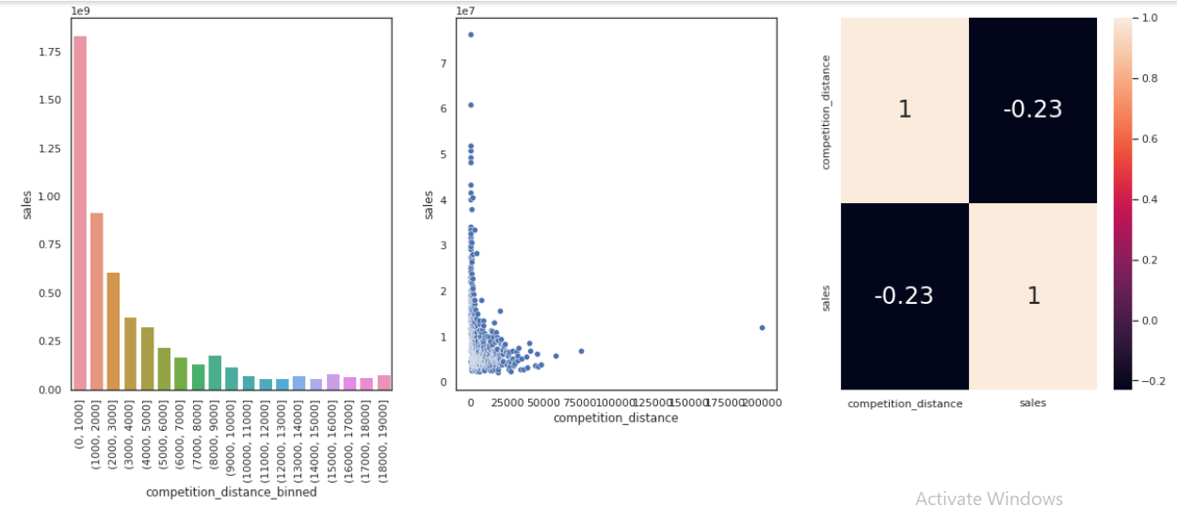
EDA(Contd.)
H2. Stores with closer competitors should sell less.
False: stores with closer competitors sell more. Competition distance and sales have a negative non linear correlaiton, which means that as the distance increases, sales decrease. That correlation (-0.23) is good enough to consider the variable important to the model.
I'll create groups for competition_distance to better visualize.

Slide 14
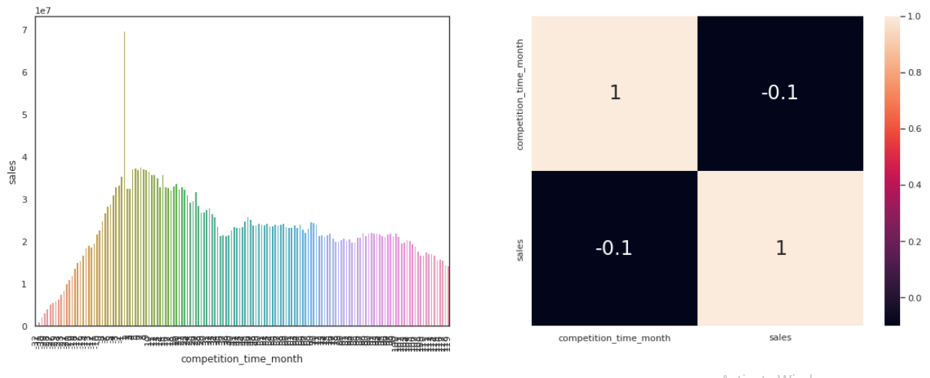
EDA(Contd.)
H3. Stores with longer competitors should sell more
False: the more recent the competition, the higher the sale. The feature is relevant to the model because its correlation with the target is not to close too zero.

Slide 15
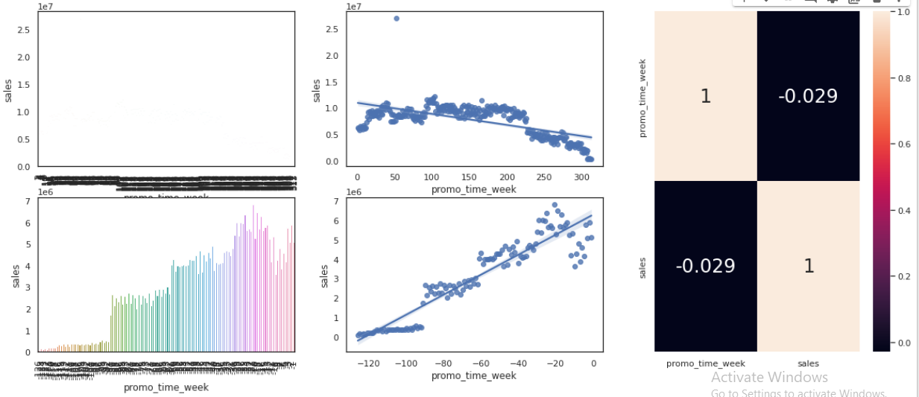
EDA(Contd.)
H4. Stores with active promotions for longer should sell more.
False: stores with active promotions for longer sell less because sales starts to decrease after a period of time. According to the correlation, there's no evidence of a strong relationship between this feature and the target.

Slide 16
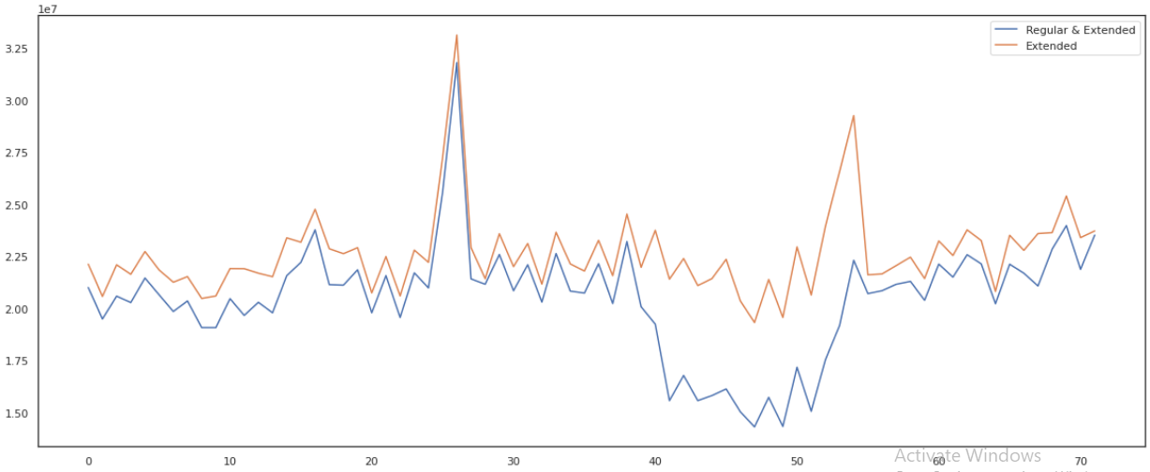
EDA(Contd.)
H6. Stores with more consecutive promotions should sell more.
False: stores with more consecutive promotions sell less. There's no such an evidence of a strong relationship between this feature and the target.

Slide 17
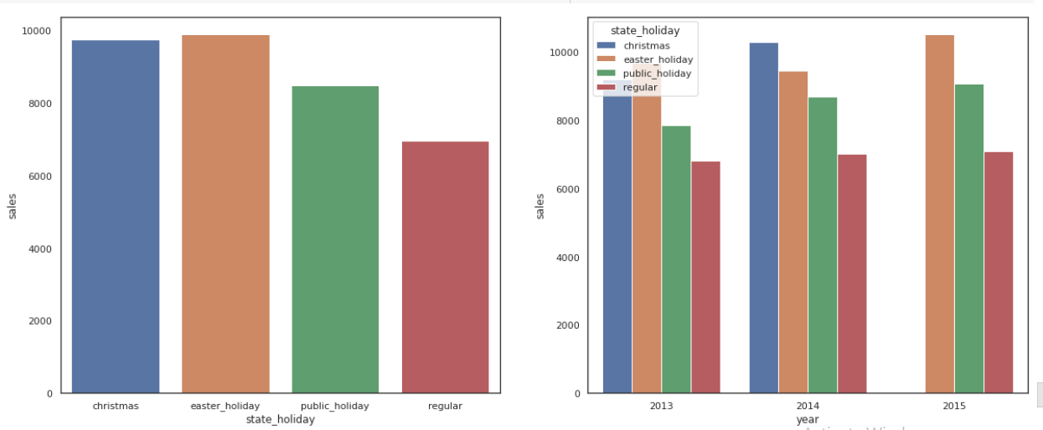
EDA(Contd.)
H7. Stores open during the Christmas holiday should sell more.
False: On average, Stores open during christmas have one of the highest sales amount, but easter holiday has a higher mean. In fact, stores sell more during holidays than during regular days. So, this feature can be considered important to the analysis

Slide 18
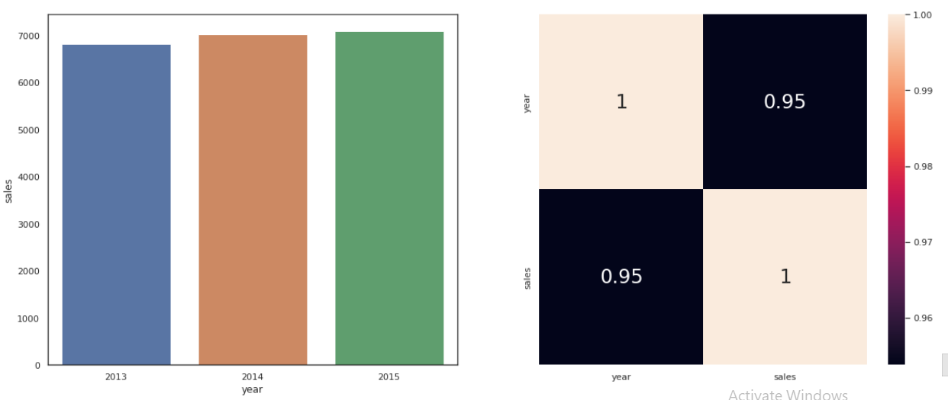
EDA(Contd.)
H8. Stores should be selling more over the years.
True: On average, sales are increasing over the year. Since the correlation is very high, this feature is important to the model.
Since 2015 is no completed yet, it's better to use mean instead of sum.

Slide 19
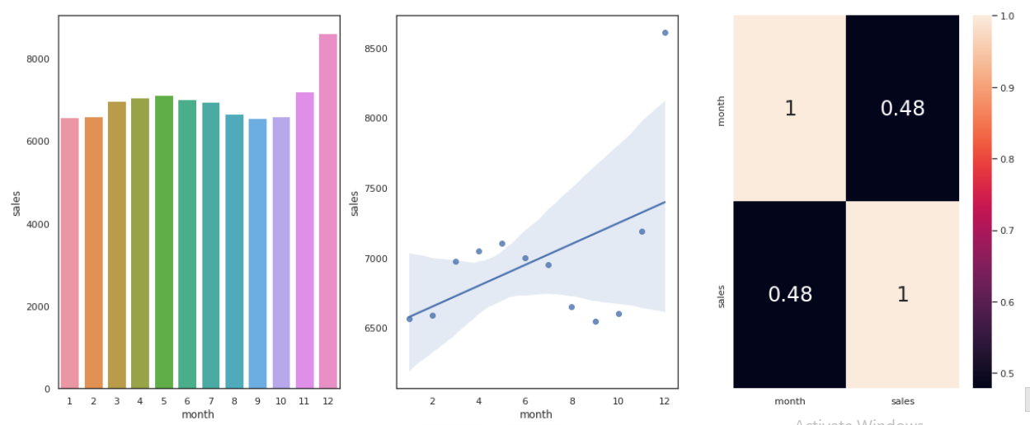
EDA(Contd.)
H9. Stores should sell more in the second half of the year.
False: Stores sell less in the second half of the year. The feature and the target have a moderate negative correlation and it can be considered important to the model.
Since 2015 is incomplete, I'll use mean instead of the sum to compare because the lack of data for the second half of the year will give us misinformation.

Slide 20
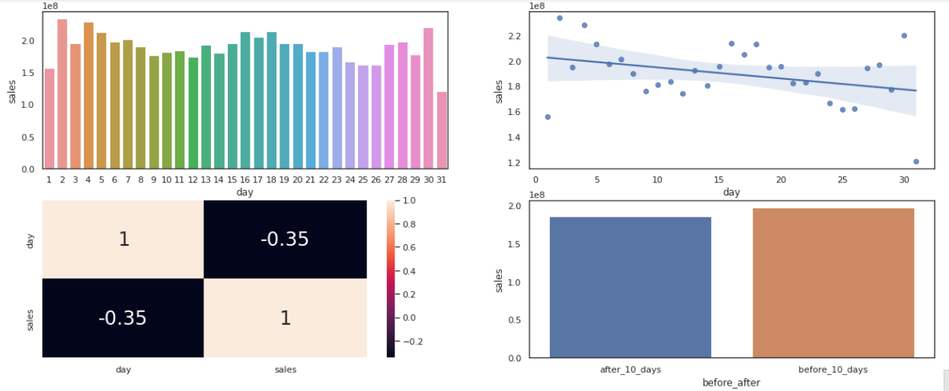
EDA(Contd.)
H10. Stores should sell more after the 10th of each month.
False: On average, there's no such a strong evidence that stores sell more after the 10th day of each month. In fact, the mean for this class is slightly smaller than for 'before_10_days'. The correlation between the feature and the target shows a relevant relationship. thus, It can be considered important to the model.

Slide 21
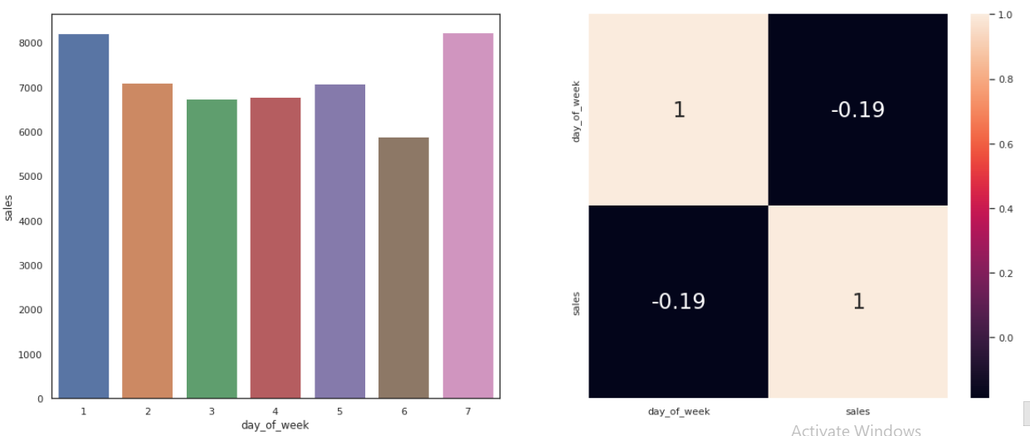
EDA(Contd.)
H11. Stores should sell less on weekends.
False: on average, I can't say that sales is lower on weekends. The correlation is strong enough to be considered in the model.

Slide 22
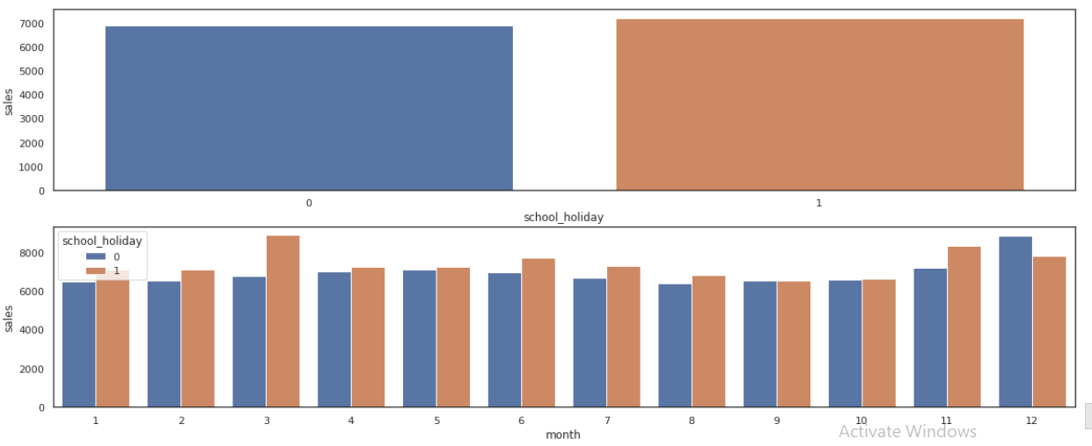
EDA(Contd.)
H12. Stores should sell less during school holidays.
False: there's no such an evidence that stores sell less during school holidays. On average, it's almost the same.

Slide 23
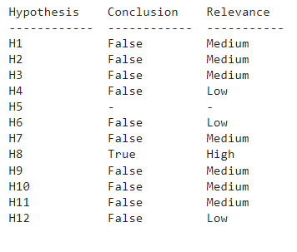
Hypothesis Validation Summary

Slide 24
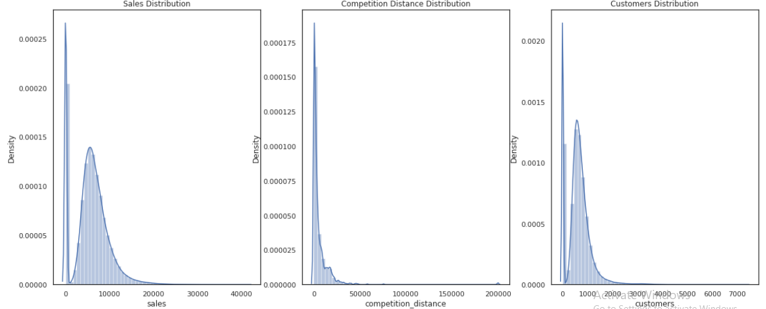
TREATING MISSING VALUES AND OUTLIERS
competition_distance:
I'll assume that if the value is missing it's because there'no competitor close to the store. Thus if I input a distance greater than the maximum distance of the column it's the same as there'no competitor close.The maximum distance is 75,860m. So, if the value is missing, I will input 200,000m
sales distribution is not normal.

Slide 25
FEATURE ENGINEERING
Feature engineering is the process of selecting, manipulating, and transforming raw data into features that can be used in supervised learning.
Feature Engineering consists of various process :
(1)Feature Creation (2) Transformation (3) Feature Extraction
Feature Extraction: Feature extraction is the process of extracting features from a data set to identify useful information.
Feature Creation: Creating features involves creating new variables which will be most helpful for our model.
Transformations: Feature transformation is simply a function that transforms features from one representation to another.

Slide 26
FEATURE ENGINEERING (Contd.)
When feature engineering activities are done correctly, the resulting dataset is optimal and contains all of the important factors that affect the business problem. As a result of these datasets, the most accurate predictive models and the most useful insights are produced.
Once we were done with creating/altering existing/new variables, we try the conditions
which are necessary for Linear regression models.
Those are –
Linearity: The relationship between the independent and dependent variables must be linear..
There should be no or little multi-collinearity: Multi-collinearity is the phenomenon
when a number of the explanatory variables are strongly correlated.
Normality: All residuals should follow a normal distribution in Linear Regression

Slide 27
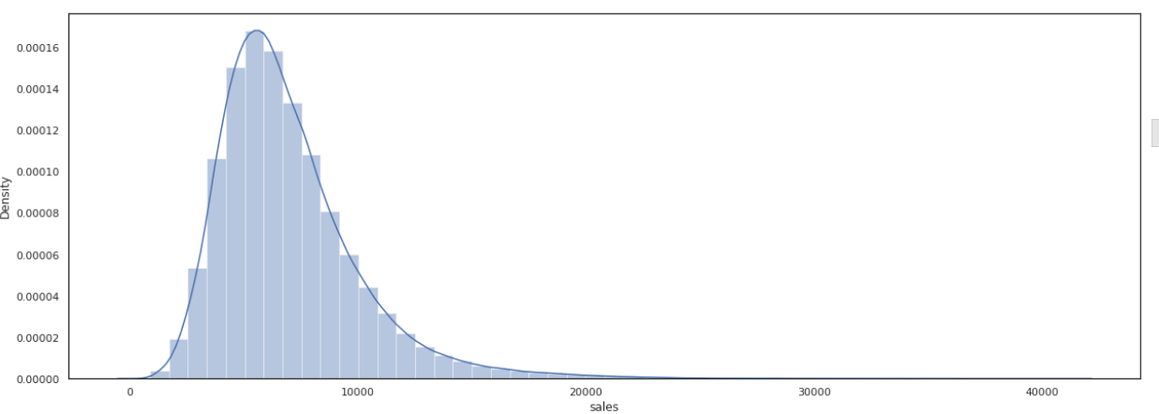
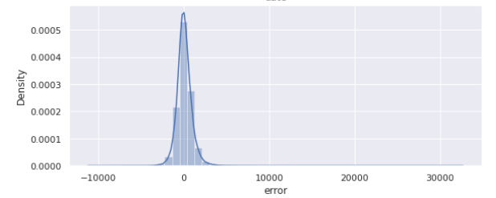
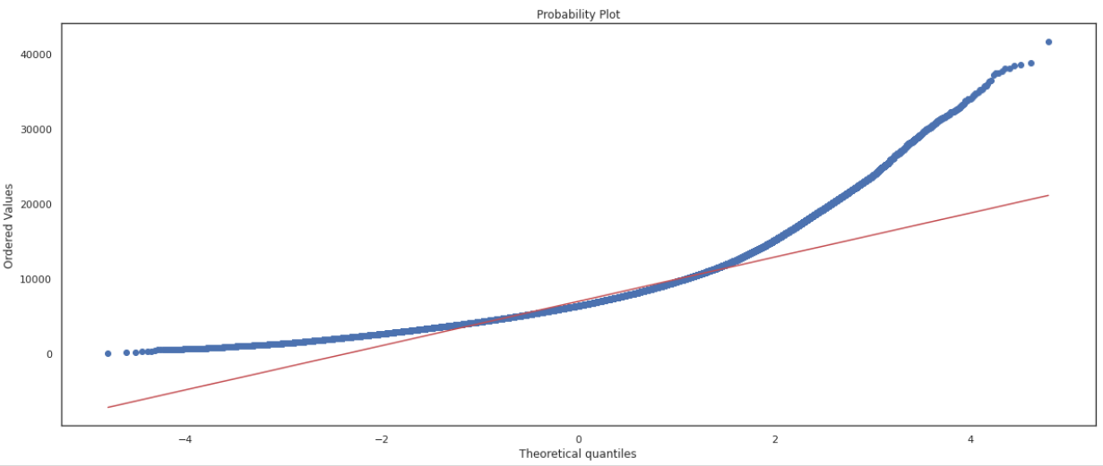
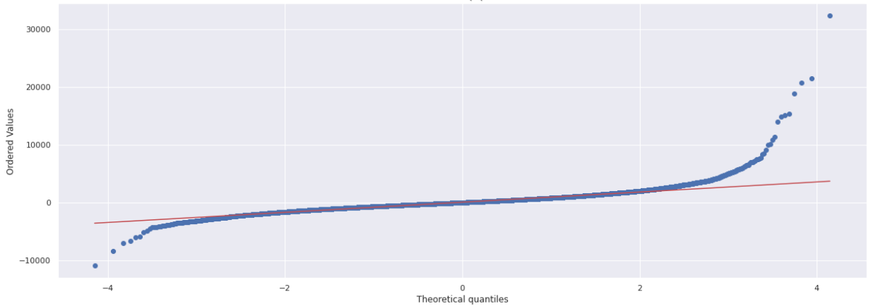
FEATURE ENGINEERING (Contd.)
Applying Transformations for the featured columns to convert it into normal distribution.

Slide 28
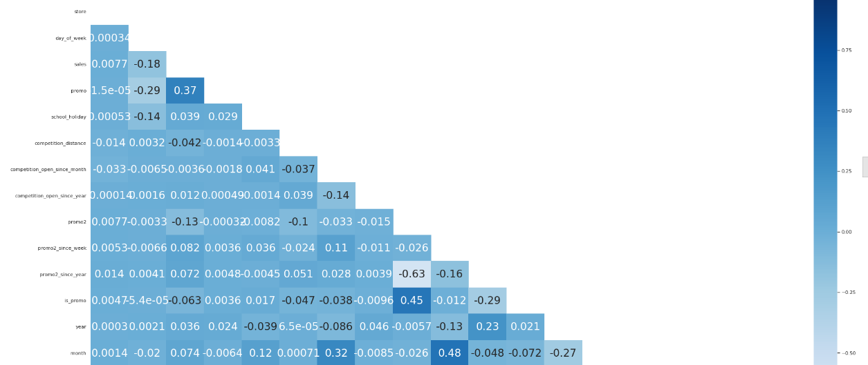
Before Building a model…
Correlation matrix for the featured variables
FEATURE SELECTION
In this section it will be selected the relevant features to the model.
I have used both Boruta and the business feeling (based on the experience from the Exploratory Data Analysis Section) to select the most relevant variables.
Boruta uses by default Random Forest to output the importance measure of a feature.
To do that, I have done following steps :
split the data frame into training and test datasets;
perform Boruta feature selector; and,
manually select features.SS

Slide 29
TRAIN – TEST SPLIT
After cleaning the data, the dataset is split into Train – Test datasets. This is done to ensure that our test dataset is completely isolated and there is no information leakage during the training process of machine learning models
DATA MODELING
In Machine Learning, we use various kinds of algorithms to allow machines to learn the relationships within the data provided and make predictions based on patterns or rules identified from the dataset.
So, regression analysis is a machine learning technique where the model predicts the output
as a continuous numerical value.
Many models were trained, from simple parametric models like Linear Regression to tree
based models.

Slide 30
DATA MODELING(Contd.)
Few of the important Regression models which we have used in here are,
Average Model – The Average Model is going to be the baseline to compare if a model is better than the mean
Linear Regression Model– This technique finds out a linear relationship between a dependent variable and the other given independent variables.
Random Forest Regressor – Random Forests are an ensemble(combination) of decision trees. It executes by constructing a different number of decision trees at training time and mean prediction (for regression) of the individual trees.

Slide 31
DATA MODELING(Contd.)
4 . Linear Regression Regularized Model – Lasso - It is a modification of linear regression, where the model is penalized for the sum of absolute values of the weights. Thus, the absolute values of weight will be (in general) reduced, and many will tend to be zeros.
5 . XGBoost Regressor – It is also a boosting technique that uses gradient descent algorithm to minimize the loss when adding new tree models.

Slide 32
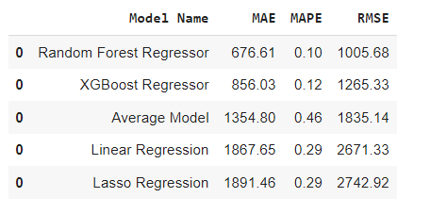
EVALUATION OF MODELS
R-squared (R2) is a statistical measure that represents the proportion of the variance for a dependent variable that’s explained by an independent variable or variables in a regression model.
Mean absolute error (MAE) is the average of the absolute difference between the actual and predicted values in the dataset. It measures the average of the residuals in the dataset
Mean Squared Error (MSE) or Mean Squared Deviation (MSD) represents the average of the squared difference between the original and predicted values in the data set. It measures the variance of the residuals. It is always non-negative, and values closer to zero are better.

Slide 33
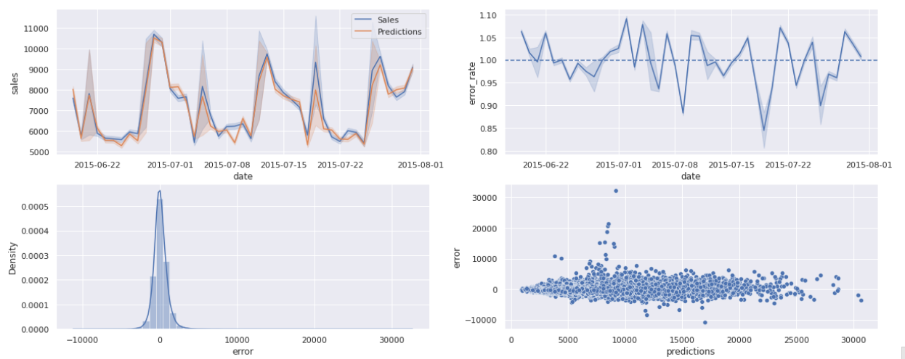
TRAIN AND TEST EVALUATION

Slide 34
CONCLUSION
The Linear Regression performed worse than the Average Model: the LR mean errors are greater than the average ones;
The data has a complex behavior (non-linear). Maybe, Linear Models can't learn its behavior;
Regularized Linear Regression performed even worse than Linear Regerssion Model.
Random Forest Regressor model got the smaller errors. However, it took too long to run (only with 100 estimators)

Slide 35
CONCLUSION(Contd.)
Business Performance:
It was provided some metrics to help making decisions. Even though there are some stores with a high percentage error and there's no way to use them, the majority of them have a low error and can be used.
It was also provided the best and the worst sales amount scenarios to the end of the six weeks. With that, we reduced the uncertainty.
Machine Learning Performance:
The predictions seem to fit well on the real sales;
The residual's distribution seems to be close to Normal. It also seems to don't have any kind of heteroscedasticity. Since I am interested in deploy the model to production fast and create value to the company, I'll hadle with these adjustments in the next cycle of the project in order to improve the model.

Slide 36
Thank You

